Slide 1
Employee Data Analysis using Excel
STUDENT NAME:MUHAMMED UWAISE TV
REGISTER NO:2213211042022
DEPARTMENT:BCOM(CORPORATE SECRETARYSHIP)
COLLEGE: PRESIDENCY COLLEGE (AUTONOMOUS),CHENNAI

Slide 2
PROJECT TITLE
Employee SALARY Analysis using Excel

Slide 3


AGENDA
Problem Statement
Project Overview
End Users
Our Solution and Proposition
Dataset Description
Modelling Approach
Results and Discussion
Conclusion
3/21/2024 Annual Review

Slide 4

PROBLEM STATEMENT
The organization faces a challenge with employee attrition, leading to increased hiring costs, loss of productivity, and a negative impact on team morale. The goal is to predict which employees are likely to leave the company so that proactive measures can be taken to retain valuable talent.

Slide 5

PROJECT OVERVIEW
This project aims to develop a predictive model that identifies employees who are at risk of leaving the company. By analyzing historical employee data, we can understand the key factors that contribute to attrition and provide actionable insights to the HR department. The model will help in reducing turnover rates, saving costs, and improving overall organizational performance

Slide 6

WHO ARE THE END USERS?
Human Resources (HR) Department: To identify at-risk employees and implement retention strategies.
Management: To make informed decisions regarding workforce planning and resource allocation.
Data Analysts/Scientists: To further refine the model and insights.

Slide 7

OUR SOLUTION AND ITS VALUE PROPOSITION
We propose developing a machine learning model that predicts employee attrition. The solution will include a detailed analysis of factors such as job satisfaction, work-life balance, performance ratings, and other demographic variables. By using this predictive model, the HR team can focus on high-risk employees and deploy targeted interventions, ultimately reducing attrition rates.

Slide 8
Dataset Description
Employee Data new:This sheet provides detailed employee information, including:•Employee ID, Full Name, Job Title, and Department:Identifiers and work details.•Business Unit, Gender, Ethnicity, Age, Hire Date, and Exit Date:Demographic and employment data.•Annual Salary and Bonus %:Compensation information.•Country and City:Location data.
Analysis:This sheet offers a summarized view of salary data by gender and department. Key columns include:•Row Labels: Departments.•Column Labels: Gender categories.•Sum of Annual Salary: Aggregated salary values by gender.•Grand Total: Total salary per department.This sheet provides insights into gender-based salary distribution and departmental salary totals.

Slide 9

THE "WOW" IN OUR SOLUTION
Diversity and Inclusion Insights:Show a breakdown of salaries by gender and ethnicity across different departments. This can highlight the organization's commitment to diversity and equitable compensation.
Compensation Trends and Forecasting:Use historical data to show trends in salaries over time. You could even project future salary expenditures based on current hiring trends and salary increases, providing strategic foresight. Performance and SalaryCorrelation:If possible, correlate salary data with performance ratings or bonuses to show how compensation aligns with employee performance.
3/21/2024 Annual Review
9

Slide 10
MODELLING
Data Preparation: We standardized date formats and addressed any missing data to ensure the dataset was complete and accurate.
Pivot Tables: These were used to efficiently summarize salary information across different departments, gender categories, and work locations.
Graphs and Visualizations: Various charts, such as bar graphs, were created to visually depict salary comparisons across departments and identify any notable trends.
Conditional Formatting: This feature was utilized to emphasize specific salary ranges and variations in employee performance, making it easier to spot key differences.
Filters: We applied filters to focus on particular employee groups, such as differentiating between full-time and part-time workers, for more targeted analysis.
10

Slide 11
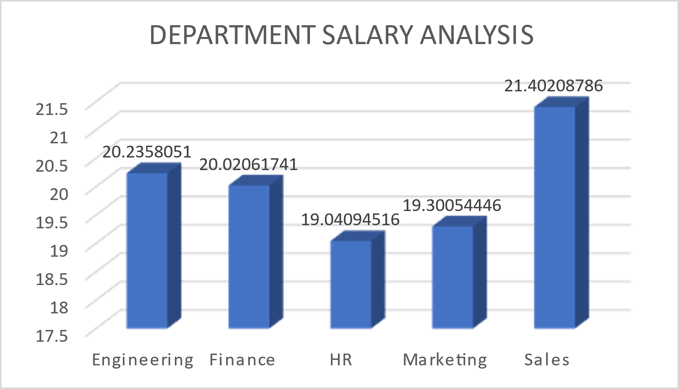
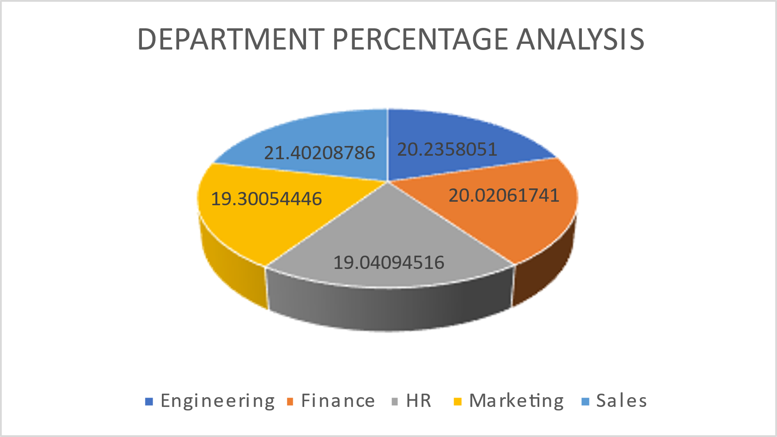
RESULTS
11

Slide 12
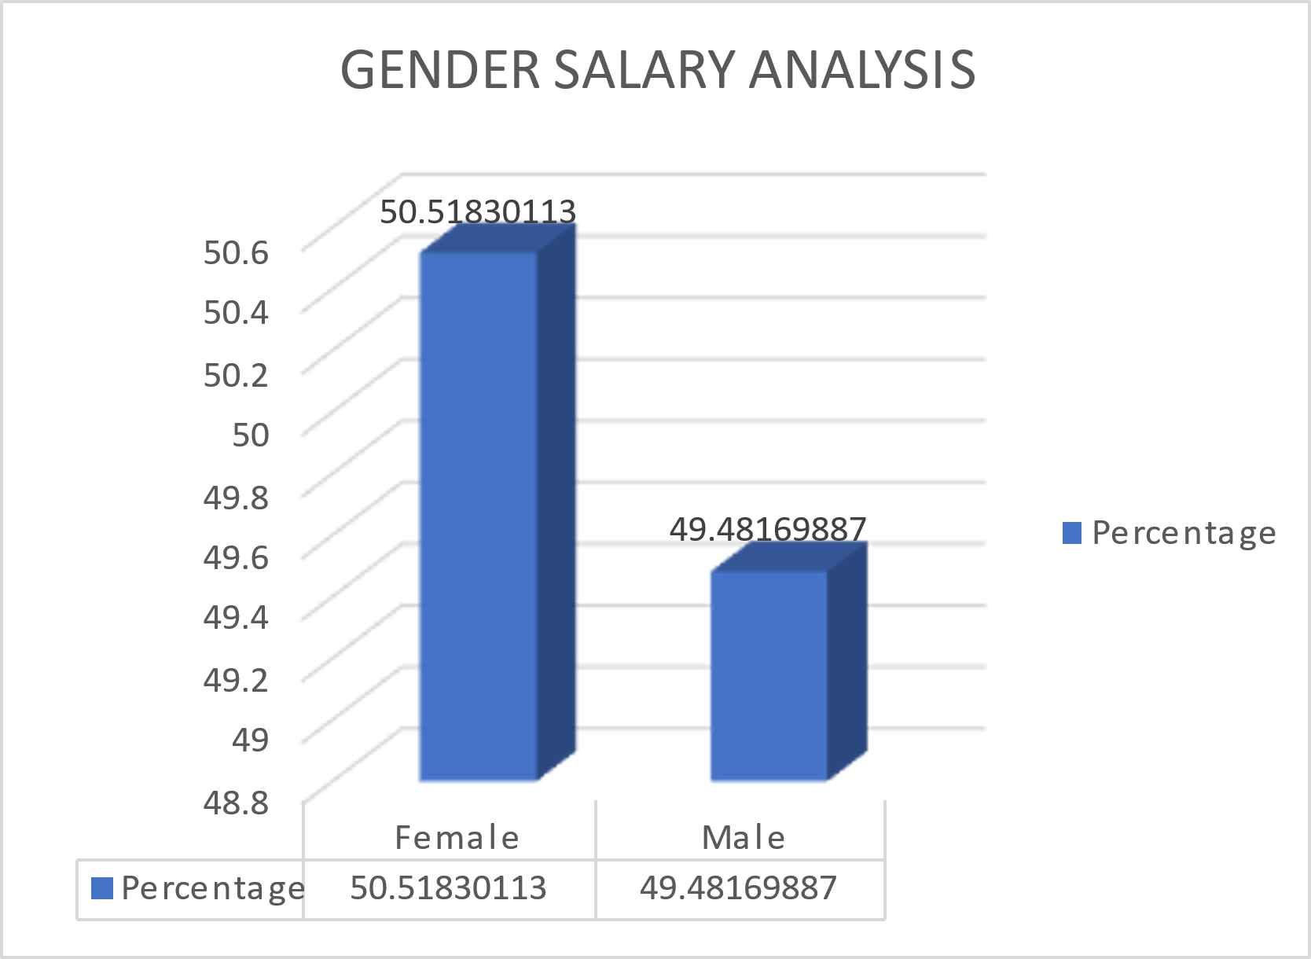
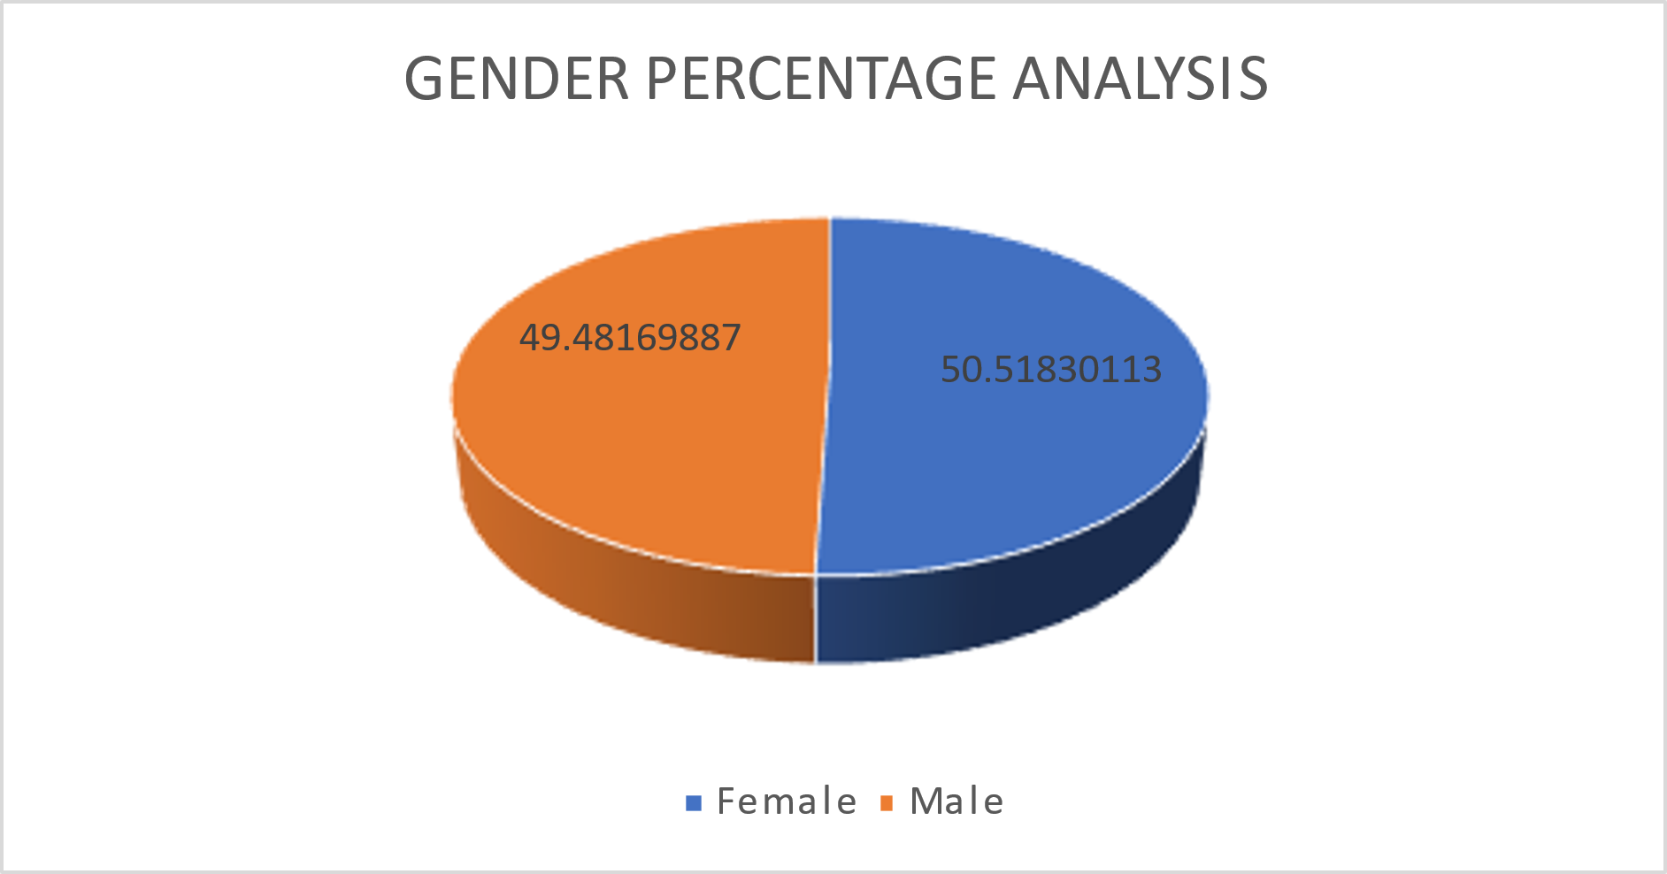
RESULTS
12

Slide 13
conclusion
The predictive model provides valuable insights into employee attrition and helps in reducing turnover by identifying at-risk employees. Implementing this model will support the HR department in making data-driven decisions, ultimately leading to a more stable and satisfied workforce.

